Slide 1
Reactive
Goal-Based
Utility-Based
Learning
Multi-Agent
ARTIFICIAL INTELLIGENCE
CO5 — Assessment Test 2 (AT-2)
Technical Presentation
Reactive, Goal-Based, Utility-Based, Learning, and Multi-Agent architectures for real-world AI systems
CO5: Design AI-based systems using PySpark, RDD operations, and intelligent agent
architectures, using scalable systems and integrate components in distributed AI applications. (BTL 5)

Slide 2

PRESENTATION 1
Reactive Agent-Based Traffic Control System
How a stateless, rule-driven agent reacts instantly to live traffic data to minimise congestion.

Slide 3


PRESENTATION 1 · SLIDE 1
Introduction & Problem Statement
The Problem
Design Goal
Fixed-timer traffic signals cause unnecessary congestion because they cannot react to actual, changing traffic volume at an intersection.
Build an agent that reacts instantly to live sensor data to minimise average vehicle wait time and queue length at every intersection.
Congestion
Real-Time Reaction
Queue Length
Reactive Agent-Based Traffic Control System

Slide 4

PRESENTATION 1 · SLIDE 2
Why This Agent Architecture?
Stateless, Direct Mapping
Low-Latency by Design
A reactive agent maps percepts directly to actions via condition-action rules and keeps no internal model of history — ideal here, since the correct signal action depends only on the current queue state, not on what happened earlier.
This keeps decision latency extremely low — essential because signal decisions must be made within the current light cycle (seconds), not after a lengthy planning process.
Condition-Action Rules
No Internal State
Millisecond Latency
Reactive Agent-Based Traffic Control System

Slide 5
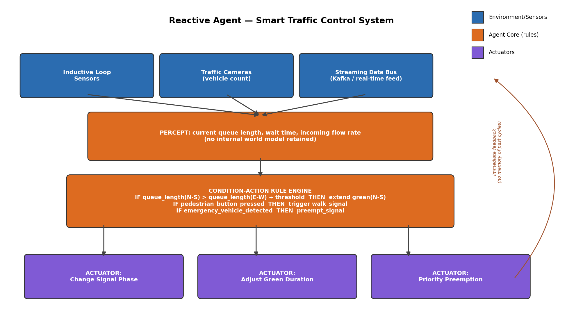
PRESENTATION 1 · SLIDE 3
System Architecture
Reactive Agent-Based Traffic Control System

Slide 6

PRESENTATION 1 · SLIDE 4
Perception: Streaming Data Processing
Streaming Ingestion
Stateless Micro-Batches
No Memory Retained
Inductive loop sensors and traffic cameras continuously publish vehicle counts and queue lengths onto a streaming bus (Kafka); PySpark Structured Streaming consumes this as a sequence of micro-batch RDDs.
Each micro-batch is processed independently, consistent with the reactive agent's stateless design — computing queue_length, wait_time, and incoming_flow_rate per lane/direction for the current instant.
No percept is retained beyond the current cycle: the very next batch starts the decision process completely fresh, with no accumulated history.
Kafka Streams
Micro-Batch RDDs
Per-Cycle Reset
Reactive Agent-Based Traffic Control System

Slide 7
PRESENTATION 1 · SLIDE 5
Condition-Action Rule Engine & Signal Management
Condition-Action Rules
Congestion Minimisation
IF queue_length(N-S) > queue_length(E-W) + threshold THEN extend green(N-S)
IF pedestrian_button_pressed THEN trigger walk_signal
IF emergency_vehicle_detected THEN preempt_signal
Rules fire in priority order every cycle, so safety rules always override routine balancing.
Green-time is dynamically extended toward the busier direction and shortened for the lighter one, rebalancing capacity to demand every cycle instead of a fixed split.
Because decisions use fresh percepts each cycle, the system self-corrects quickly after sudden shifts (e.g. an accident) that a static timer plan cannot handle.
Reactive Agent-Based Traffic Control System

Slide 8

PRESENTATION 1 · SLIDE 6
Advantages & Limitations
Advantages
Limitations
Extremely fast response time
Simple to implement and verify
Scales to many independent intersections — each only needs local percepts
No memory of past states, so it cannot anticipate recurring patterns (e.g. daily rush hour)
Cannot proactively coordinate across multiple intersections without an added planning/learning layer
Best Fit: Localized, time-critical control loops where the correct action depends only on the current sensor reading.
Reactive Agent-Based Traffic Control System

Slide 9

PRESENTATION 1 · CONCLUSION
Reactive Agent-Based Traffic Control System
A reactive agent architecture, combined with real-time streaming data processing, is well-suited to traffic signal control because it delivers the low-latency, locally-optimal decisions the problem demands — at the cost of not learning or planning across longer time horizons.
Condition-Action Rules
Streaming RDDs
Sub-Second Response

Slide 10

PRESENTATION 2
Goal-Based Agent for Healthcare Diagnosis
How an agent formulates diagnostic goals and plans a sequence of tests and treatments to reach them.

Slide 11
PRESENTATION 2 · SLIDE 1
Introduction & Problem Statement
The Problem
Design Goal
Diagnosis is not a single lookup — it is a process of narrowing down possibilities toward a specific, actionable conclusion while managing risk and cost (e.g. unnecessary tests).
Build an agent that treats diagnosis as a goal to be achieved through a sequence of reasoned actions, not a fixed reflex response.
Differential Diagnosis
Risk vs. Benefit
Goal-Directed Care
Goal-Based Agent for Healthcare Diagnosis

Slide 12

PRESENTATION 2 · SLIDE 2
Why This Agent Architecture?
Explicit, Persistent Goals
Weighing Cost & Risk
Unlike a reactive agent, a goal-based agent maintains an explicit goal (e.g. 'confirm or rule out condition X') and considers the future consequences of actions before choosing one.
This is essential in healthcare, where actions (tests, treatments) carry costs and risks that must be weighed against how much they help reach the diagnostic goal.
Explicit Goal State
Consequence Reasoning
Cost-Aware Actions
Goal-Based Agent for Healthcare Diagnosis

Slide 13
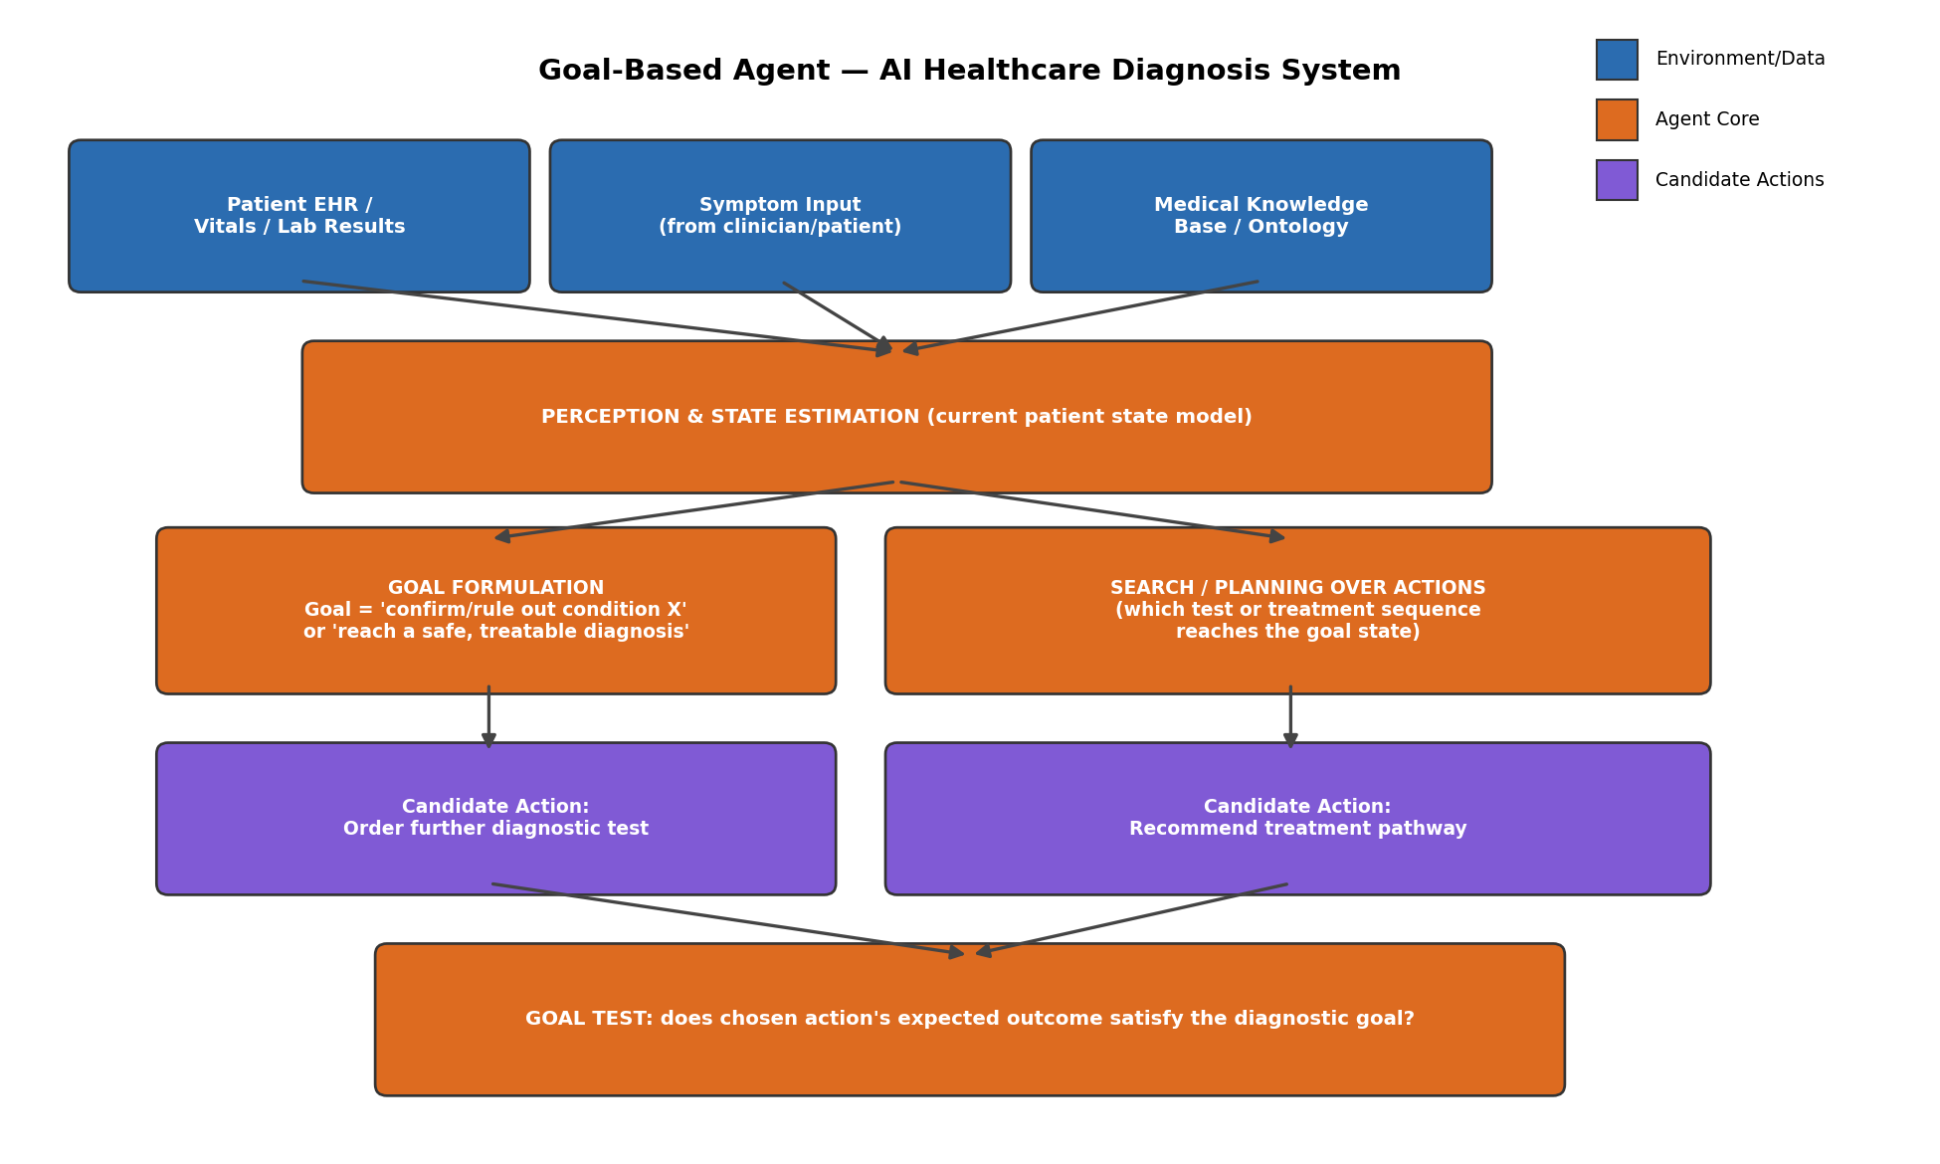
PRESENTATION 2 · SLIDE 3
System Architecture
Goal-Based Agent for Healthcare Diagnosis

Slide 14

PRESENTATION 2 · SLIDE 4
Data Pipeline & Patient State Estimation
Continuous Data Pipeline
Persistent Patient-State Model
Patient EHR records, live vitals, lab results, and clinician-entered symptoms feed a data pipeline that continuously updates a structured patient-state model.
This persistent state model is what distinguishes the goal-based agent from a reactive one: it accumulates evidence across the whole diagnostic encounter, not just the current percept.
EHR Integration
State Accumulation
Evidence Tracking
Goal-Based Agent for Healthcare Diagnosis

Slide 15
PRESENTATION 2 · SLIDE 5
Goal Formulation, Planning & Treatment Selection
Goal Formulation & Search
Goal Test & Treatment Pathway
Given ambiguous symptoms, the agent formulates a specific goal such as 'rule out condition X' or 'reach a diagnosis with sufficient confidence to prescribe safely.'
It then searches over possible test sequences using the medical knowledge base to predict which sequence most efficiently reaches the goal state.
After each new piece of evidence, a goal test checks whether the patient-state model satisfies the diagnostic goal with sufficient confidence.
Once satisfied, the agent selects the treatment pathway whose predicted outcome best matches the diagnosis and patient-specific constraints (allergies, comorbidities, cost).
Goal-Based Agent for Healthcare Diagnosis

Slide 16
PRESENTATION 2 · SLIDE 6
Advantages & Limitations
Advantages
Limitations
Explicitly reasons about future consequences of actions
Can justify recommended tests/treatments in terms of the goal
Adapts its plan as new evidence arrives
Requires an accurate, well-structured knowledge base
Can be computationally expensive to search many test/treatment sequences for complex cases
Does not itself weigh competing goals numerically (cost vs. speed vs. accuracy) without a utility-based extension
Best Fit: Multi-step decision processes where actions must be justified against an explicit, evolving objective.
Goal-Based Agent for Healthcare Diagnosis

Slide 17
PRESENTATION 2 · CONCLUSION
Goal-Based Agent for Healthcare Diagnosis
Framing diagnosis and treatment selection as goal-directed search over a continuously-updated patient state allows the agent to behave like a careful clinician working systematically toward a conclusion, rather than reacting to isolated symptoms.
Goal Formulation
Search & Planning
Goal Test

Slide 18

PRESENTATION 3
Utility-Based Agent for E-Commerce Recommendations
How the agent scores every candidate product by a utility function to maximise customer satisfaction.

Slide 19
PRESENTATION 3 · SLIDE 1
Introduction & Problem Statement
The Problem
Design Goal
A recommendation is rarely a single 'correct' answer — many products could reasonably be shown, and the platform must choose the ones that actually maximise customer satisfaction.
Build an agent that ranks options by a measurable degree of desirability, not a binary goal-satisfied/not-satisfied test.
Personalisation
Degree of Desirability
Customer Satisfaction
Utility-Based Agent for E-Commerce Recommendations

Slide 20
PRESENTATION 3 · SLIDE 2
Why This Agent Architecture?
Utility Over Binary Goals
Satisfaction Is a Matter of Degree
A utility-based agent assigns a real-valued utility to each possible outcome and chooses the action that maximises expected utility.
This fits e-commerce because 'a good recommendation' is inherently a matter of degree — more relevant, cheaper, better rated — rather than a single goal that is either met or not.
Real-Valued Utility
Expected-Value Maximisation
Graded Preferences
Utility-Based Agent for E-Commerce Recommendations

Slide 21
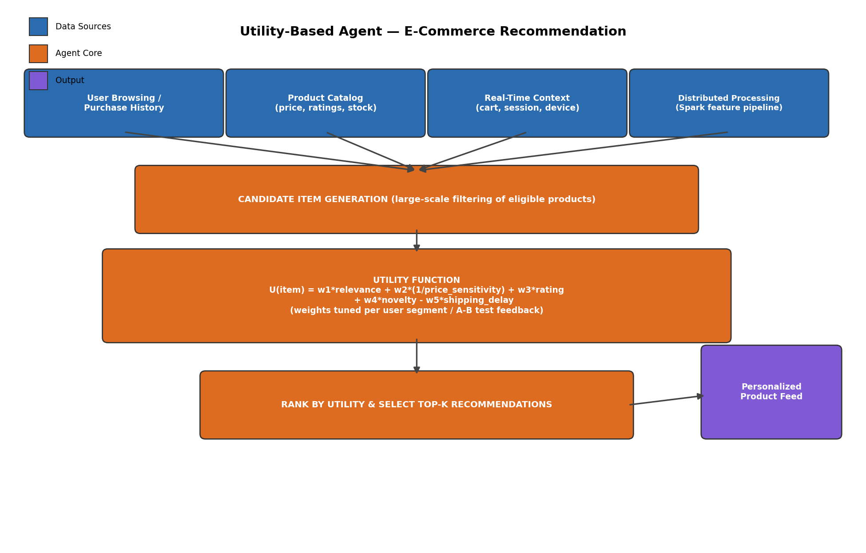
PRESENTATION 3 · SLIDE 3
System Architecture
Utility-Based Agent for E-Commerce Recommendations

Slide 22
PRESENTATION 3 · SLIDE 4
Large-Scale Data Processing
Distributed Feature Pipeline
Candidate Filtering
User browsing/purchase history, the full product catalog, and real-time session context (cart, device) are combined at scale using a distributed feature pipeline (PySpark), since a large platform must score millions of user-item pairs.
A first filtering stage narrows the catalog to a manageable candidate set (e.g. items in browsed categories, in stock) before the more expensive utility computation runs — keeping the pipeline scalable.
PySpark Feature Pipeline
Candidate Generation
Millions of Pairs
Utility-Based Agent for E-Commerce Recommendations

Slide 23
PRESENTATION 3 · SLIDE 5
The Utility Function & Ranking
Multi-Attribute Utility Function
Ranking & Output
U(item) = w1·relevance + w2·(1/price_sensitivity)
+ w3·rating + w4·novelty − w5·shipping_delay
Each term captures one dimension of what makes a recommendation good for this specific user; weights are tuned per user segment and refined via A/B tests.
Every candidate item's utility is computed, items are ranked in descending order, and the top-K items form the personalised feed.
Because utility is a single combined score, trade-offs are handled automatically — a cheaper or better-rated item can outrank a 'more relevant' but costlier one.
Utility-Based Agent for E-Commerce Recommendations

Slide 24
PRESENTATION 3 · SLIDE 6
Advantages & Limitations
Advantages
Limitations
Naturally handles trade-offs between competing factors (price, relevance, rating, delay)
Gives a single interpretable ranking score
Adapts smoothly as weights are retrained
Requires careful weight-tuning and enough behavioural data per user segment to be reliable
A poorly-calibrated utility function can systematically over/under-value one factor
Best Fit: Ranking problems with many competing, gradable factors rather than one clear pass/fail outcome.
Utility-Based Agent for E-Commerce Recommendations

Slide 25
PRESENTATION 3 · CONCLUSION
Utility-Based Agent for E-Commerce Recommendations
Utility-based reasoning turns 'maximise customer satisfaction' from a vague objective into a concrete, tunable scoring function that can rank any number of candidate products consistently at scale.
Utility Function
Weighted Trade-offs
Top-K Ranking

Slide 26

PRESENTATION 4
Learning Agent for Personalized Education System
How the agent improves its own teaching policy over time using feedback from student performance.

Slide 27
PRESENTATION 4 · SLIDE 1
Introduction & Problem Statement
The Problem
Design Goal
A fixed, one-size-fits-all curriculum either bores advanced students or overwhelms struggling ones; the ideal system continuously adjusts difficulty to each learner's evolving ability.
Build an agent whose recommendation policy actually improves over time from experience, rather than remaining static after deployment.
Adaptive Difficulty
Continuous Improvement
Per-Learner Pacing
Learning Agent for Personalized Education System

Slide 28
PRESENTATION 4 · SLIDE 2
Why This Agent Architecture?
Improves From Feedback
Difficulty Isn't Known in Advance
A learning agent is the only classical architecture that explicitly improves its own performance element using feedback from a critic.
This is necessary here because the 'right' difficulty level for a given student is not known in advance and must be discovered and refined from observed outcomes.
Critic Feedback
Self-Improving Policy
Discovered, Not Fixed
Learning Agent for Personalized Education System

Slide 29
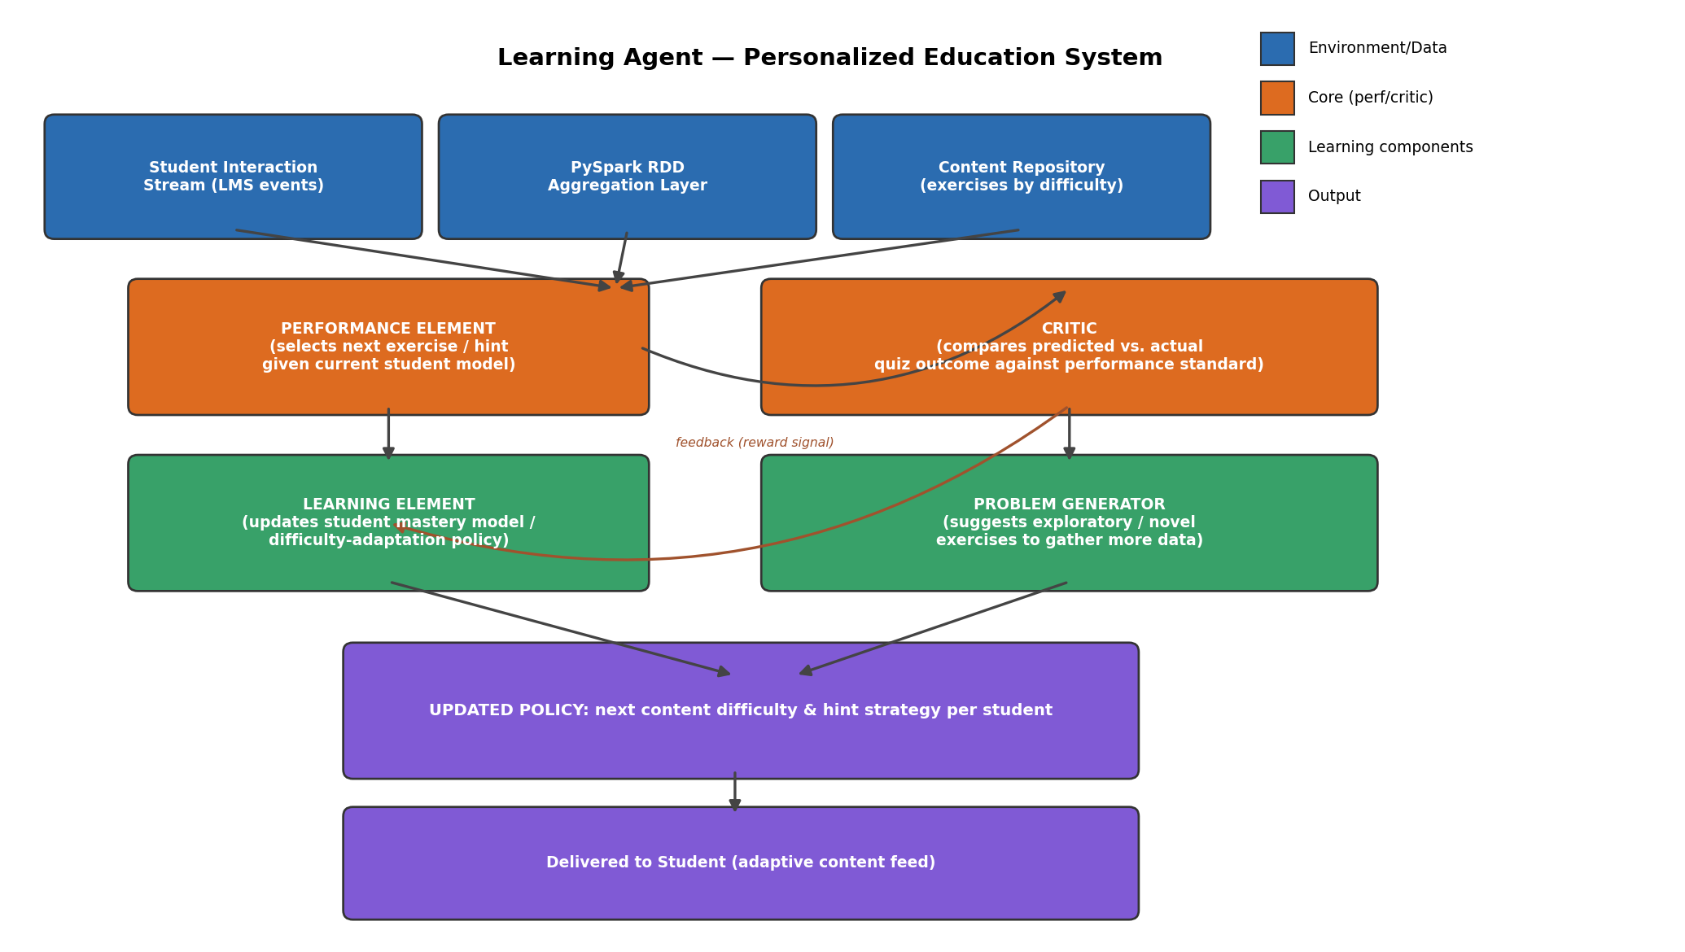
PRESENTATION 4 · SLIDE 3
System Architecture
Learning Agent for Personalized Education System

Slide 30
PRESENTATION 4 · SLIDE 4
Performance Element & Critic
Performance Element
Critic
Selects the next exercise, hint, or explanation to present, based on the current student model (estimated mastery per topic).
Compares the predicted outcome (expected quiz score) against the actual outcome, producing a feedback/reward signal indicating whether the last decision was well-calibrated.
Mastery Model
Predicted vs. Actual
Reward Signal
Learning Agent for Personalized Education System

Slide 31
PRESENTATION 4 · SLIDE 5
Learning Element, Problem Generator & PySpark Scale
Learning Element & Problem Generator
Integration with PySpark
The Learning Element uses the Critic's feedback to update the student mastery model and difficulty-adaptation policy — this is where real improvement happens over time.
The Problem Generator occasionally suggests exploratory exercises so the system keeps gathering informative data, preventing stale mastery estimates.
Clickstream, quiz, and video-engagement events from thousands of learners are aggregated using PySpark RDD operations (groupByKey by student_id, aggregateByKey for running averages).
Partitioning RDDs by student_id lets each student's model update run independently and in parallel, keeping feedback near real-time at scale.
Learning Agent for Personalized Education System

Slide 32
PRESENTATION 4 · SLIDE 6
Advantages & Limitations
Advantages
Limitations
Genuinely improves over time without manual re-tuning
Personalises at scale across many concurrent learners
Problem generator prevents premature convergence to a suboptimal policy
Cold-start: needs enough interaction data per student before estimates become reliable
Exploratory exercises can occasionally present a mismatched difficulty level in service of long-run learning
Best Fit: Long-running, personalized systems where the optimal policy per user is unknown and must be learned from feedback.
Learning Agent for Personalized Education System

Slide 33
PRESENTATION 4 · CONCLUSION
Learning Agent for Personalized Education System
The four-component learning-agent architecture, combined with PySpark-based distributed aggregation, lets a personalised education platform continuously refine what it delivers to each learner while scaling to a large, concurrent student population.
Performance + Critic
PySpark at Scale
Continuous Improvement

Slide 34
PRESENTATION 5
Multi-Agent System for Disaster Management
How specialised sensor, decision, communication, and coordination agents collaborate on a shared bus.

Slide 35
PRESENTATION 5 · SLIDE 1
Introduction & Problem Statement
The Problem
Design Goal
Disaster detection and response naturally spans many specialised sub-tasks — sensing, image analysis, communication with field units, and decision-making — best handled by separate, cooperating components.
Build a multi-agent system where specialised agents share evidence and coordinate a response faster and more reliably than any single agent could alone.
Multi-Source Evidence
Specialised Sub-Tasks
Coordinated Response
Multi-Agent System for Disaster Management

Slide 36


PRESENTATION 5 · SLIDE 2
Why This Agent Architecture?
Specialised Expertise per Source
Concurrent, Cooperating Agents
Each data source (sensors, imagery, social reports, field units) requires different expertise to interpret, and the geographic scale of a disaster means processing must be distributed.
A MAS lets each agent specialise and operate concurrently while still contributing evidence toward one shared, coordinated decision.
Distributed Processing
Concurrent Agents
Shared Decision
Multi-Agent System for Disaster Management

Slide 37
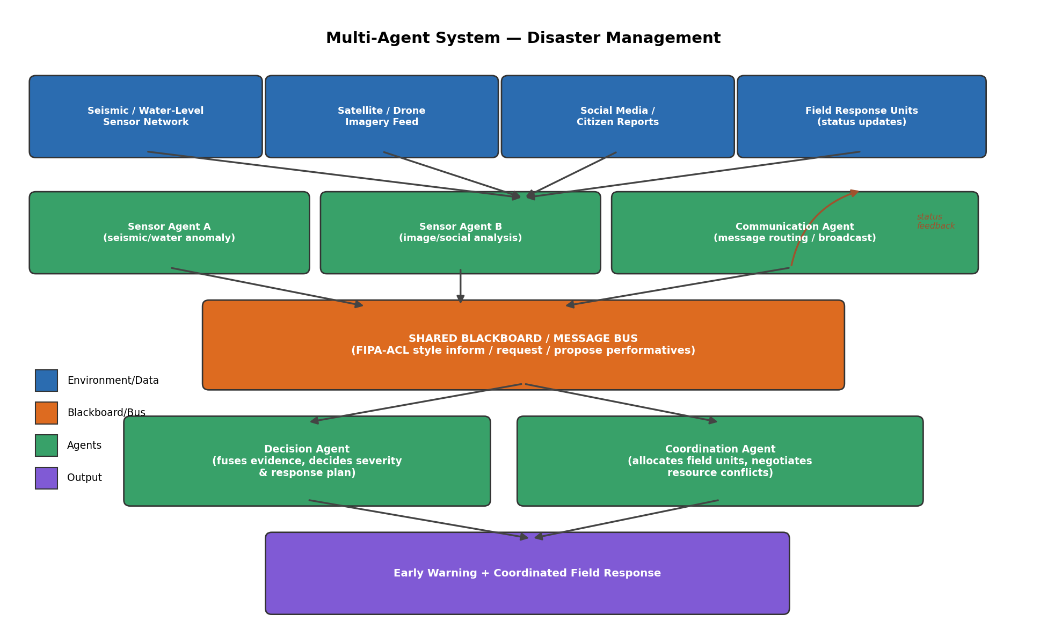
PRESENTATION 5 · SLIDE 3
System Architecture
Multi-Agent System for Disaster Management

Slide 38


PRESENTATION 5 · SLIDE 4
Agent Roles
Sensor Agents
Decision Agent
Communication & Coordination Agents
Agent A processes seismic/water-level sensor streams for statistical anomalies; Agent B processes satellite/drone imagery and social-media reports for corroborating evidence.
Fuses evidence from both sensor agents to assess disaster likelihood and severity, and formulates a response plan.
Route messages and broadcast warnings; allocate field units and resolve resource conflicts across affected zones.
Anomaly Detection
Evidence Fusion
Field-Unit Allocation
Multi-Agent System for Disaster Management

Slide 39
PRESENTATION 5 · SLIDE 5
Coordination Strategy & Real-Time Decision-Making
Shared Blackboard / Message Bus
Real-Time Coordination
Agents communicate via a shared blackboard using structured performatives (inform, request, propose — FIPA-ACL style) rather than direct point-to-point calls.
This lets the Decision Agent fuse independently-generated evidence from multiple sensor agents into one coherent severity assessment.
As new evidence streams in, the Decision Agent continuously re-evaluates severity, and the Coordination Agent adjusts field-unit allocation on the fly rather than committing to a static plan.
Field units report status back, closing the loop and avoiding duplicated or conflicting responses.
Multi-Agent System for Disaster Management

Slide 40
PRESENTATION 5 · SLIDE 6
Advantages & Limitations
Advantages
Limitations
Specialisation improves the quality of each sub-task
Agents can be added or scaled independently
Shared-blackboard communication is robust to individual agent slowdowns or failures
Requires careful protocol/message design to avoid conflicting instructions between agents
Overall latency depends on the slowest agent in a decision chain — coordination overhead must stay fast enough for genuine emergencies
Best Fit: Large-scale, multi-source problems where specialised, concurrently-operating components must reach one coordinated decision.
Multi-Agent System for Disaster Management

Slide 41
PRESENTATION 5 · CONCLUSION
Multi-Agent System for Disaster Management
A multi-agent architecture with a shared communication layer lets a disaster-management system combine specialised, concurrently-operating agents into one fast, corroborated early-warning and response capability that a single centralised agent would struggle to match.
Shared Blackboard
Specialised Agents
Real-Time Coordination

